Slide 1
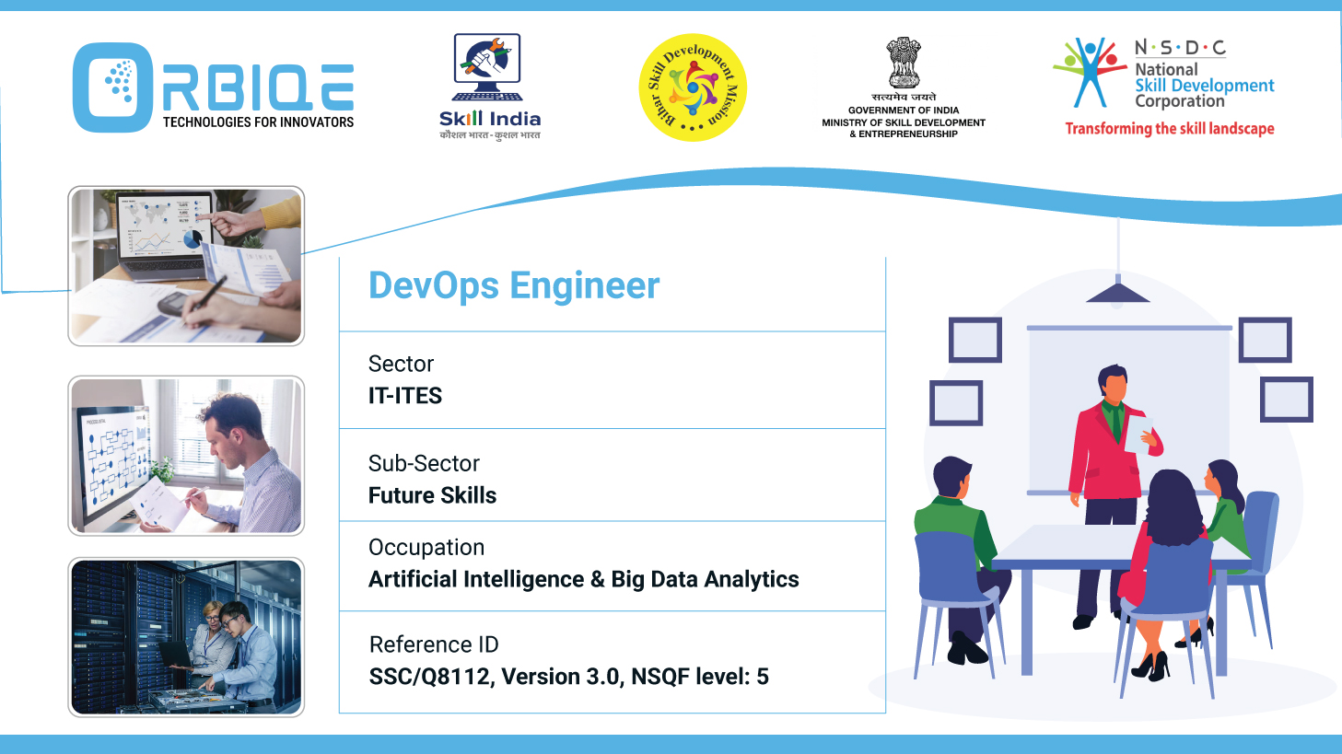
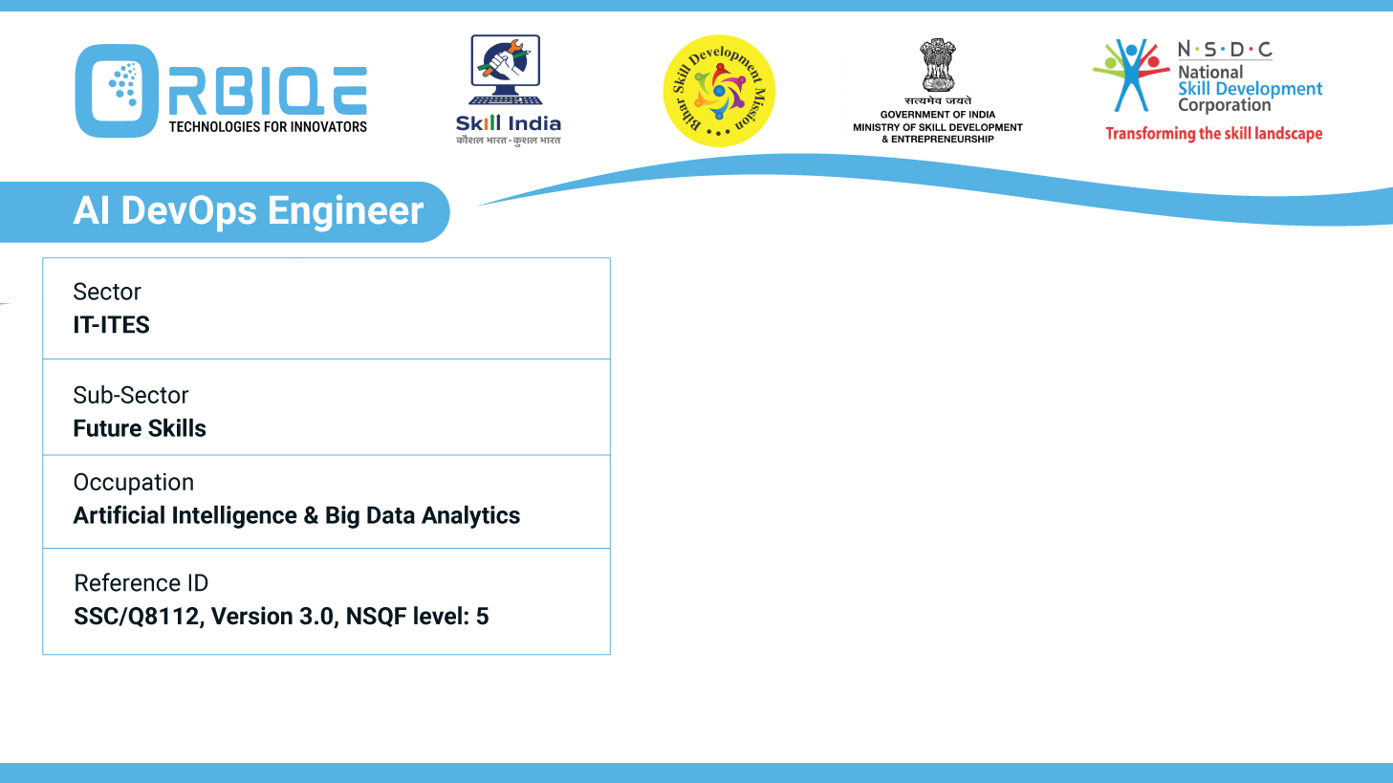
Name- Krishna Kant Dubey

Slide 2

Assessing CI/CD Strategies and Best Practices

Slide 3
Agenda
“fail fast, fix fast” approach
Implementing infrastructure as code (IaC)
Utilizing feature for safe experimentation

Slide 4
“fail fast, fix fast” approach

Slide 5
Implementing infrastructure as code (IaC)

Slide 6
Utilizing feature for safe experimentation

Slide 7
Thank You

